Slide 1
Industrial experiences in the use of static analysis
Zoltán Porkoláb
ELTE Eötvös Loránd University, Faculty of Informatics
Department of Programming Languages and Compilers
gsd@inf.elte.hu
zoltan.porkolab@ericsson.com
https://gsd.web.elte.hu

Slide 2


Introduction

Slide 3


Introduction

Slide 4
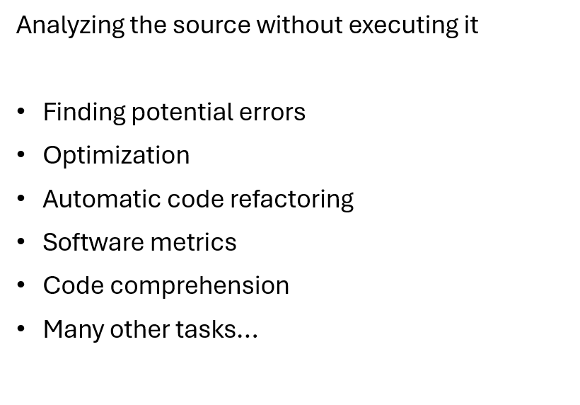
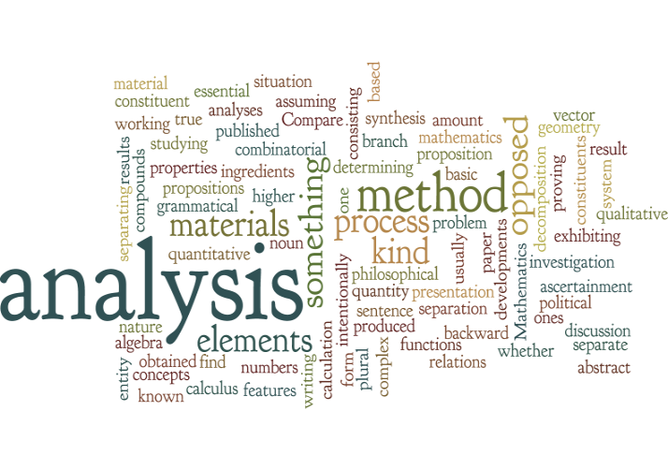

Static analysis

Slide 5
Static analysis

Slide 6
Static analysis

Slide 7
Comprehension is a major cost factor
Research | Effort for comprehension
IBM (Corbi, 1989) | Over 50% of time
Bell Labs (Davison, 1992) | New project members: 60-80% of time, drops to 20% as one gains experience
National Research Council in Canada (Singer, 2006) | Over 25% of time either searching for or looking at code
Microsoft (Hallam, 2006) | Equal amount of time as design, test
Microsoft (La Toza, 2007) | Over 70% of time
Microsoft (Cherubini, 2007) | 95%~ significant part of job 65%< at least once a day 25%< multiple times of a day

Slide 8
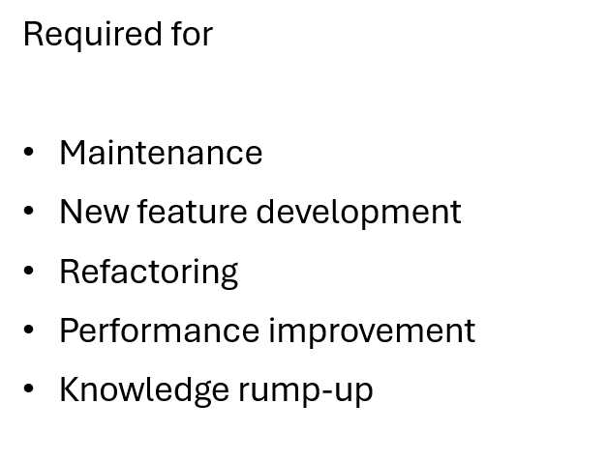
Comprehension is a major cost factor

Slide 9
Tool support is required

Slide 10

Tool support is required

Slide 11

Tool support is required

Slide 12
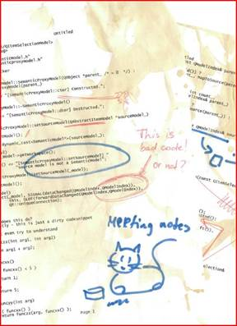
Tool support is required

Slide 13
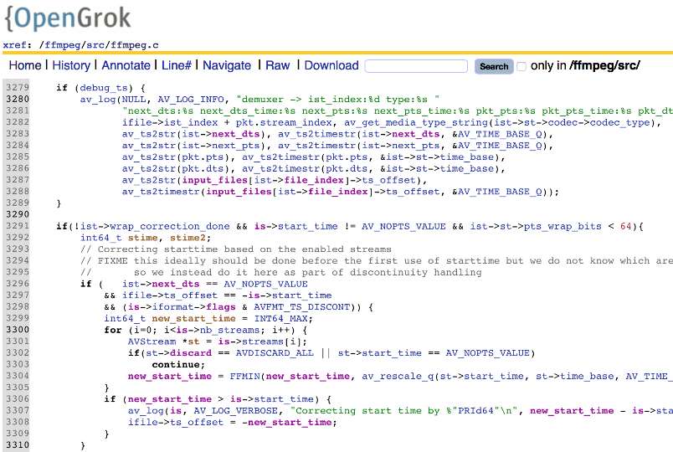
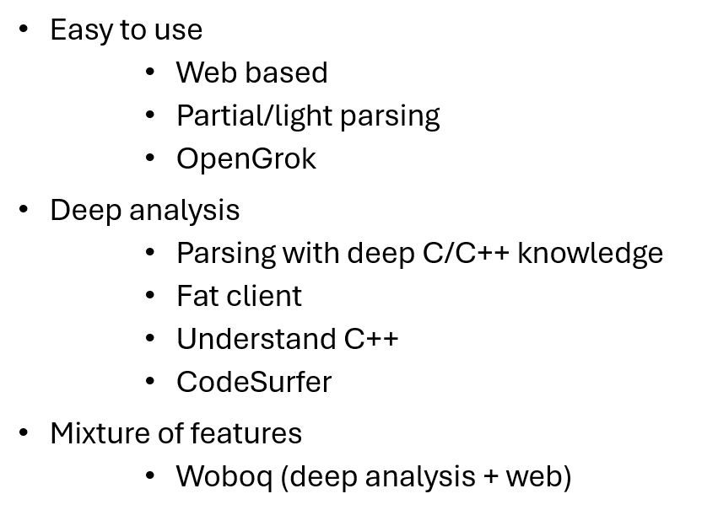
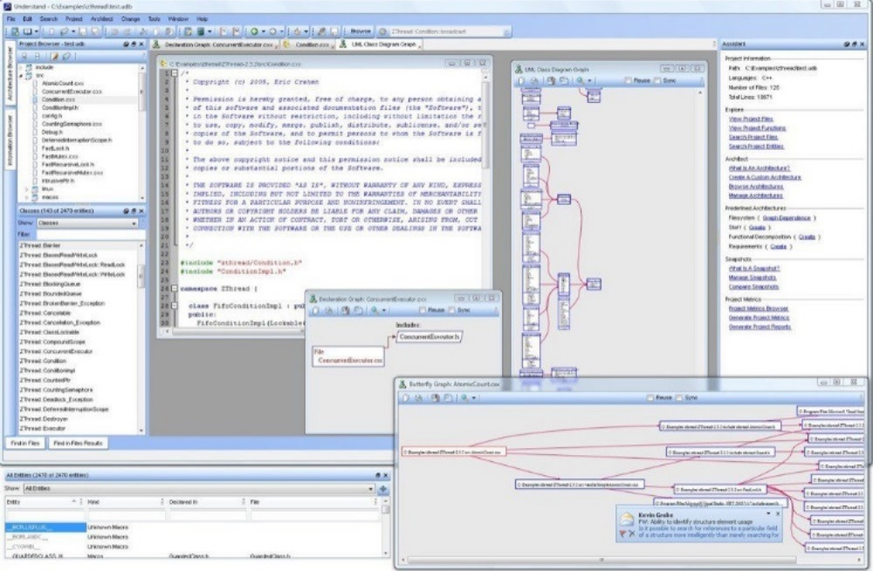
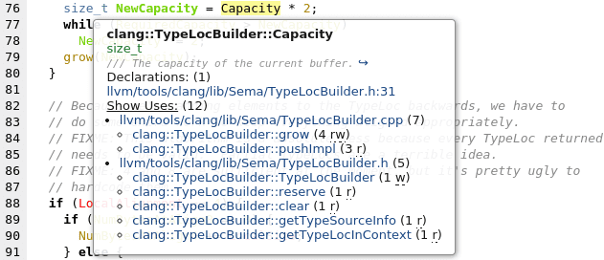
Existing tools

Slide 14
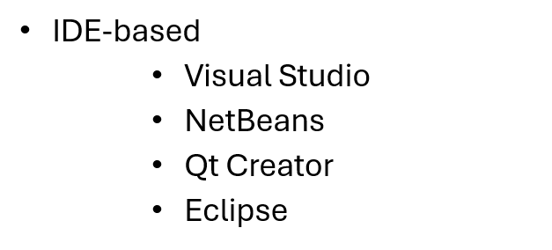
Existing tools

Slide 15
Comprehension requires specific feature list
Development of code | Understanding code
Writing new code (support: code completion, etc.) | Reading and navigating inside code
Intentions are clear | Intensions are weak
Working with only a few files at the same time | Frequently jumping between many different files
Edit, compile, fix, repeat | Visualize
Working on the same abstraction level for a while | Jumping between various abstraction levels (Google map of code)

Slide 16
Comprehension requires specific feature list

Slide 17
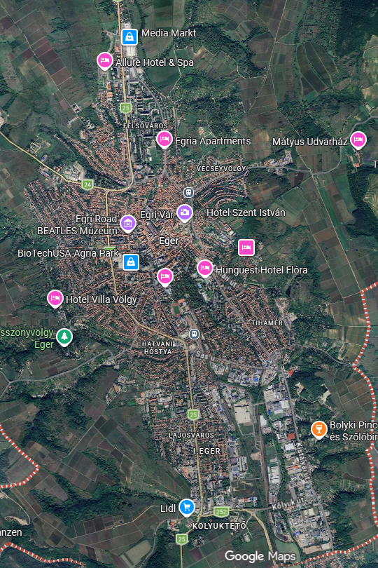
Comprehension requires specific feature list

Slide 18
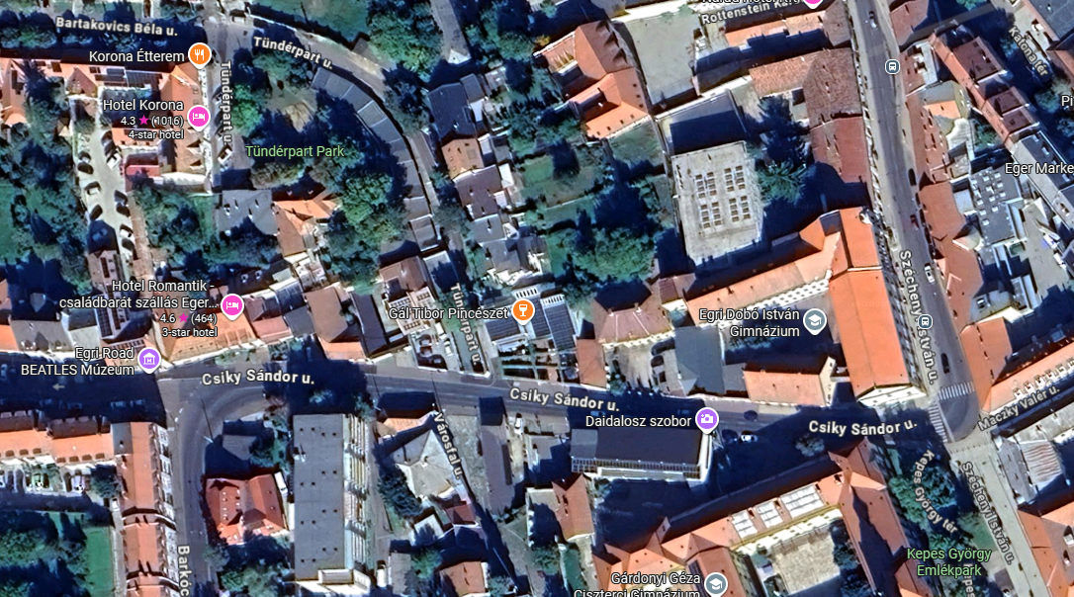
Comprehension requires specific feature list

Slide 19
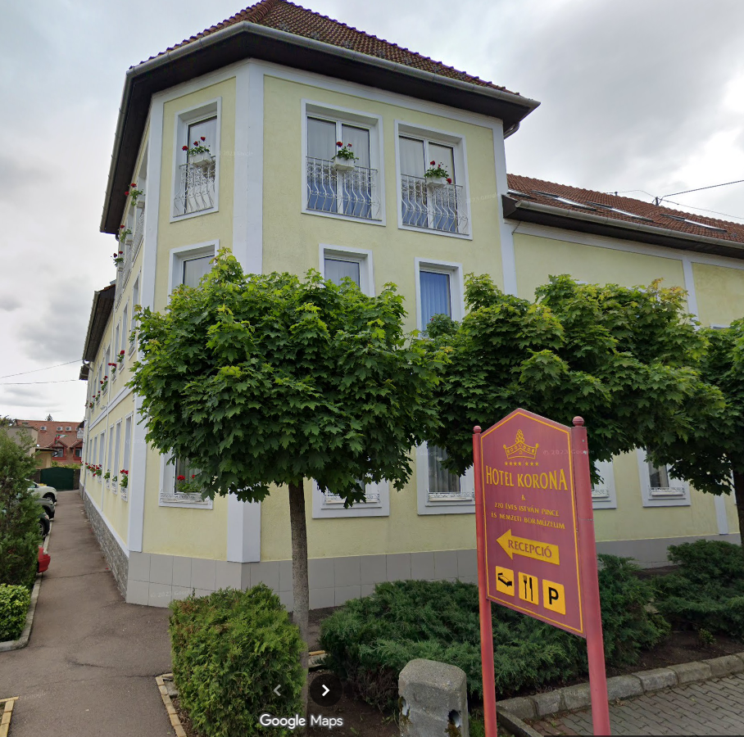
Comprehension requires specific feature list

Slide 20
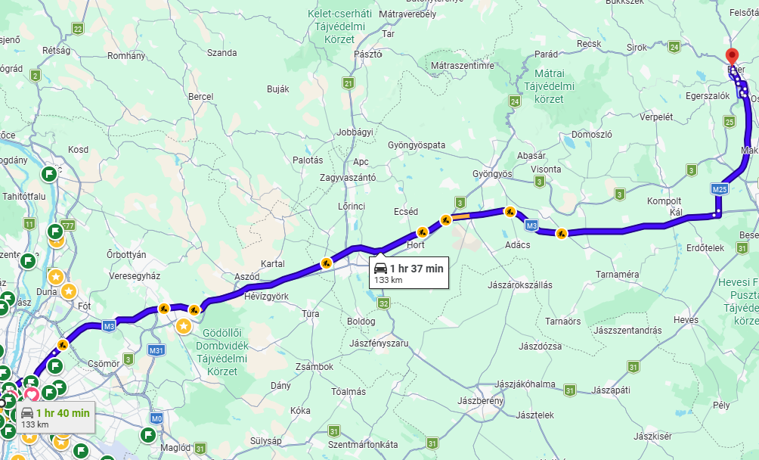
Comprehension requires specific feature list

Slide 21
Comprehension requires specific feature list

Slide 22
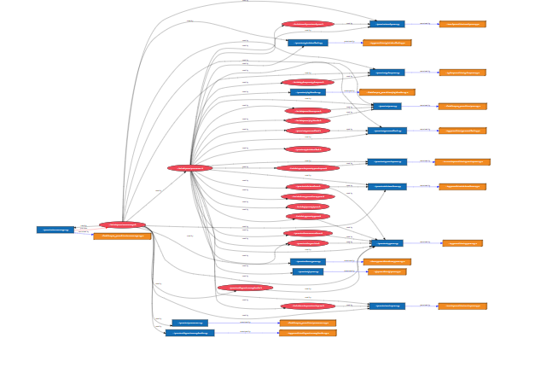
Comprehension requires specific feature list

Slide 23
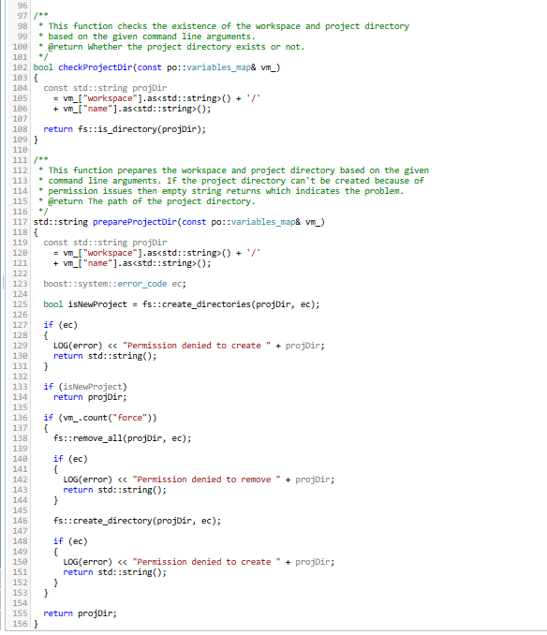
Comprehension requires specific feature list

Slide 24
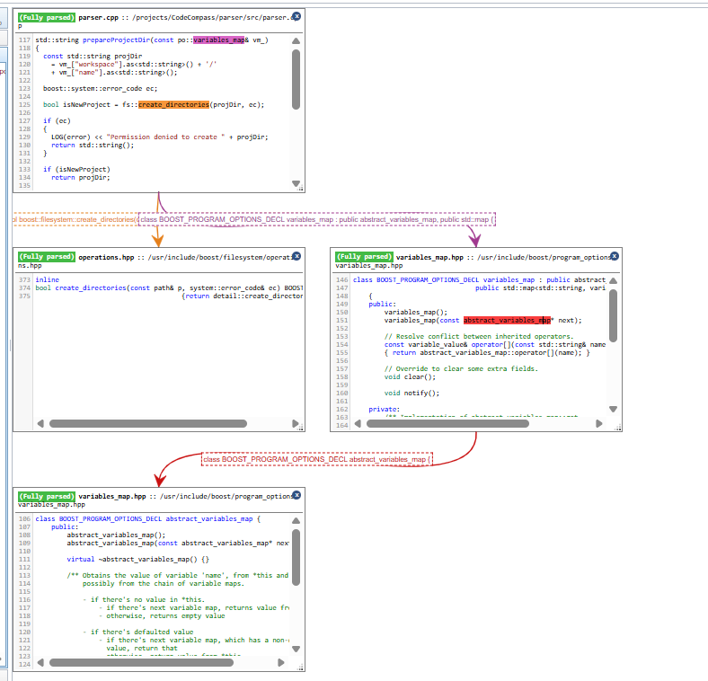
Comprehension requires specific feature list

Slide 25
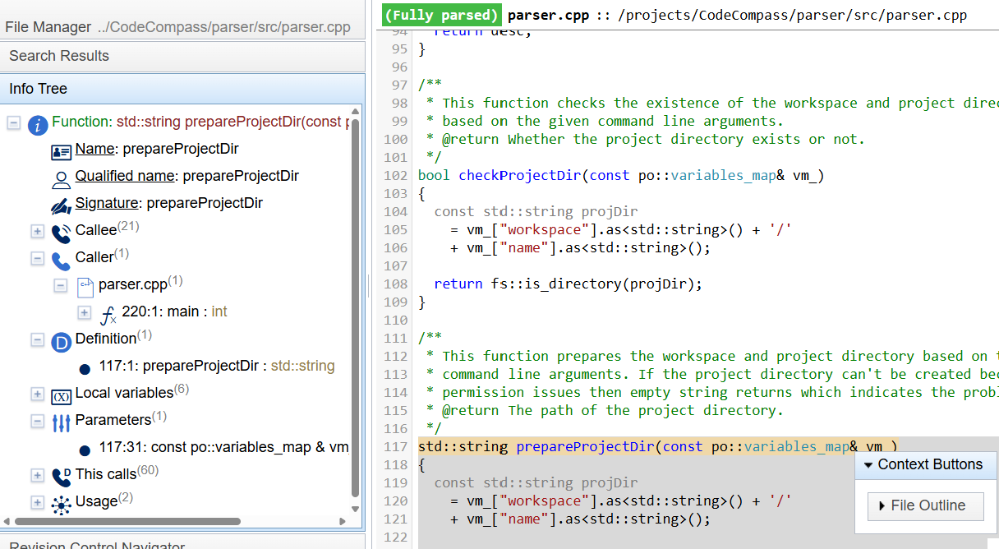
Comprehension requires specific feature list

Slide 26
Comprehension requires specific feature list
Deep analysis + build information
Fast text- based feature location
Architectural information
Textual summaries
(Interactive) Visualizations
Working on the whole knowledge portfolio
Scalability ( >10 millions LOC )
Fast user interface ( <1sec )
Communication between developers (permalinks)
Extendibility: open-source platform

Slide 27

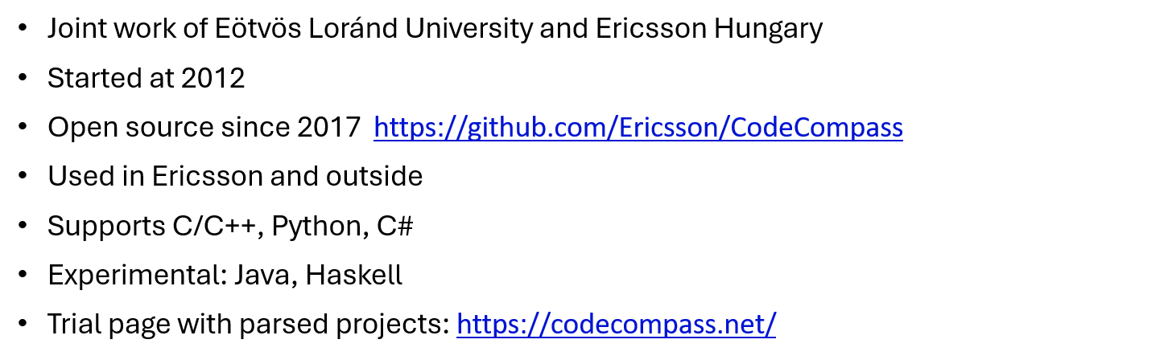
CodeCompass: an open-source comprehension framework

Slide 28
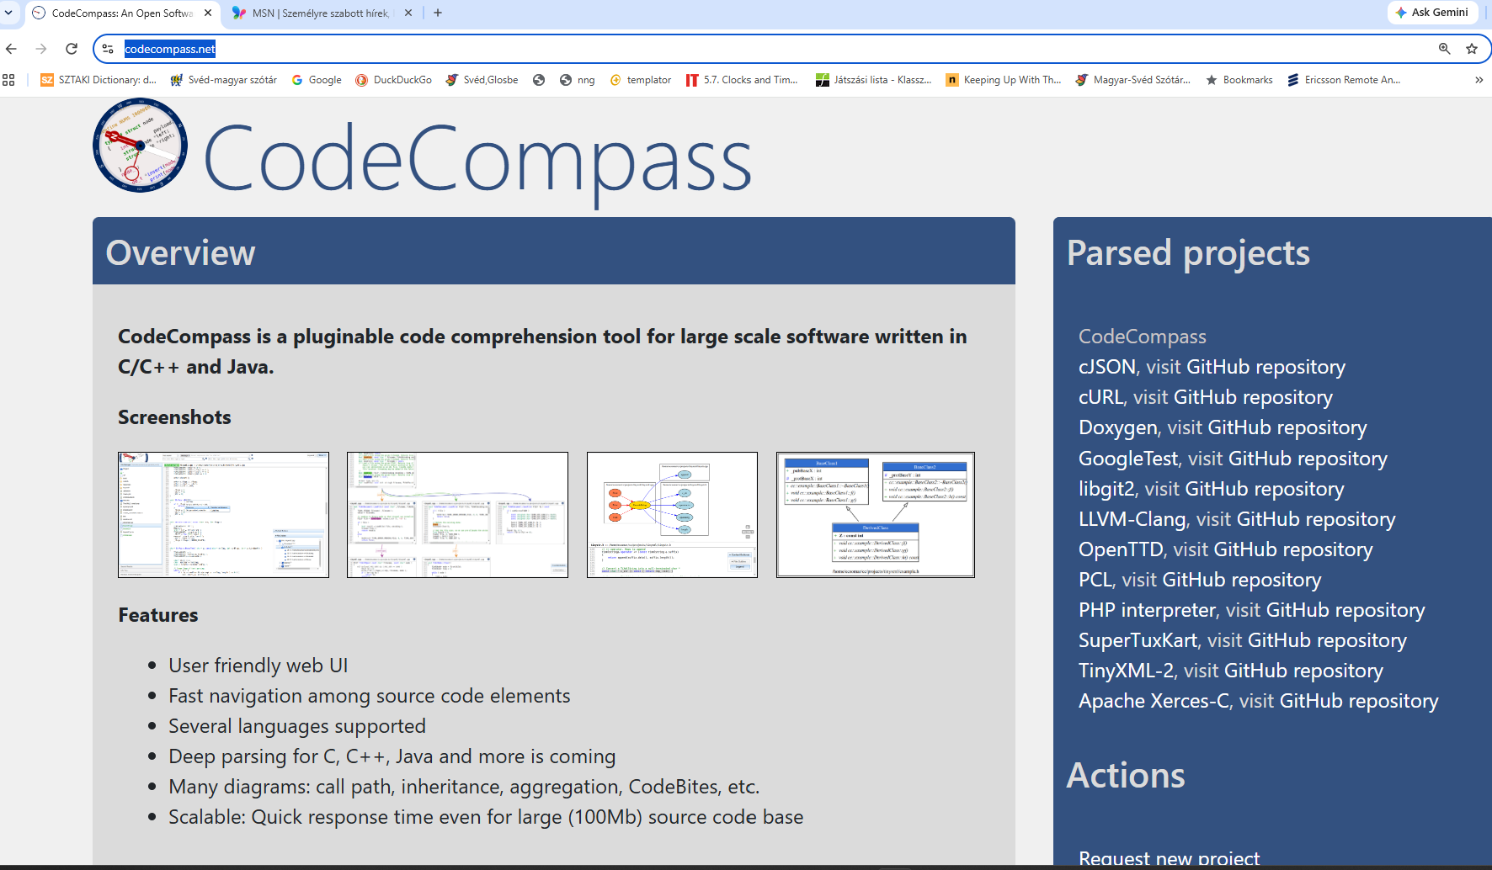
CodeCompass trial page

Slide 29
CodeCompass architecture

Slide 30
Design choice: storage
Store the Abstract Syntax Tree
    Produced by Clang
    All information is there
Problem: size
    1:200-500 ratio between source and AST
    Easily grown over 50GB + indexes
Not scalable
Reason
    Header duplications

Slide 31
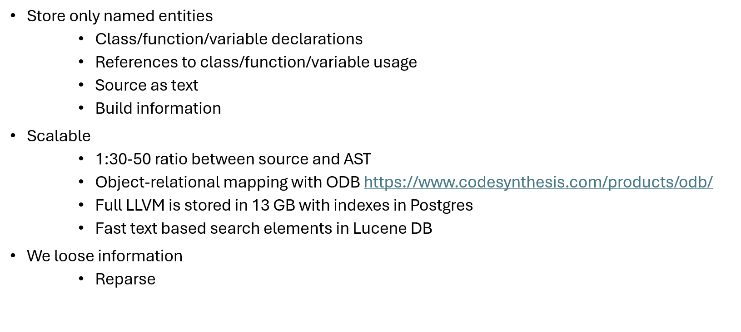
Design choice: storage

Slide 32
Typical workflow

Slide 33
Typical workflow
  Fast feature location
    Textual search
    Log-base search

Slide 34
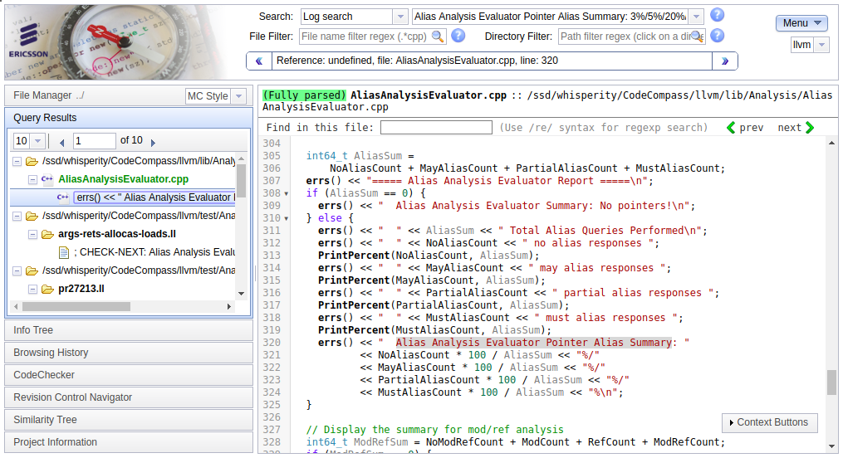
Fast feature location / log search

Slide 35
Typical workflow
  Fast feature location
    Textual search
    Log-base search
  Extend knowledge
    Info tree
    CodeBites view
    Function call chains
    Browsing history

Slide 36
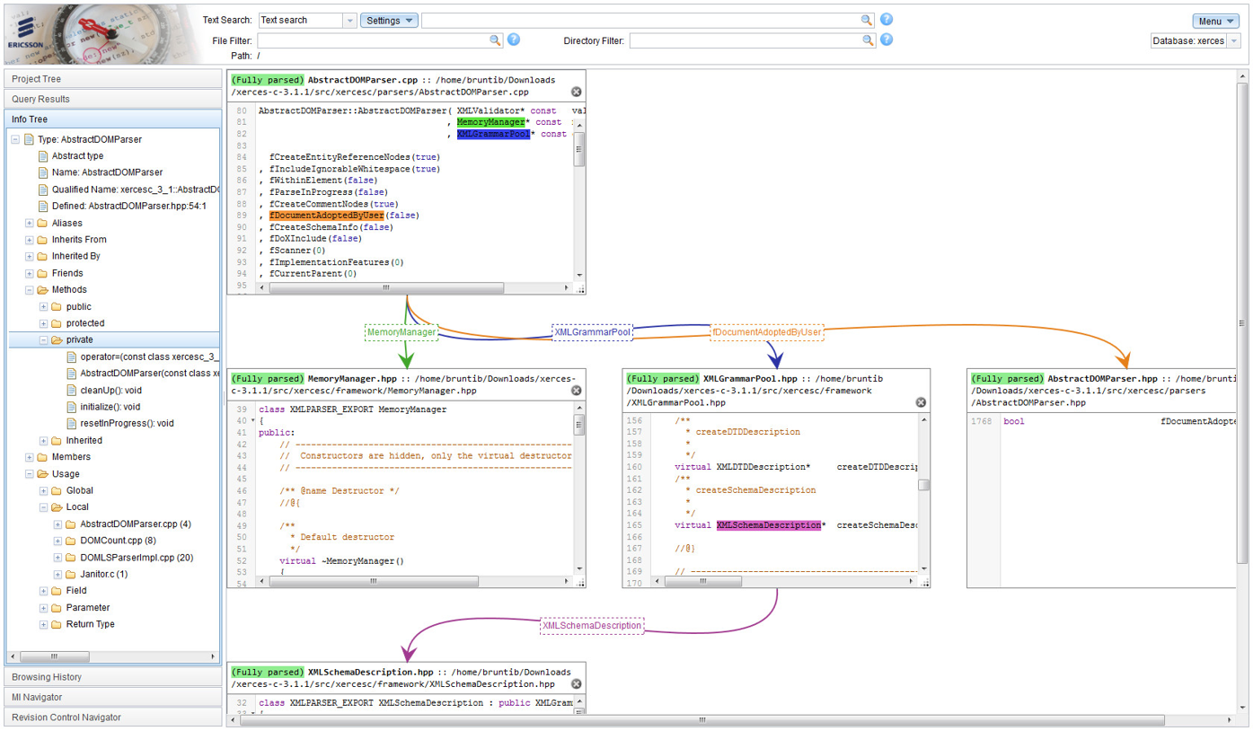
Easy code browsing -- CodeBites

Slide 37
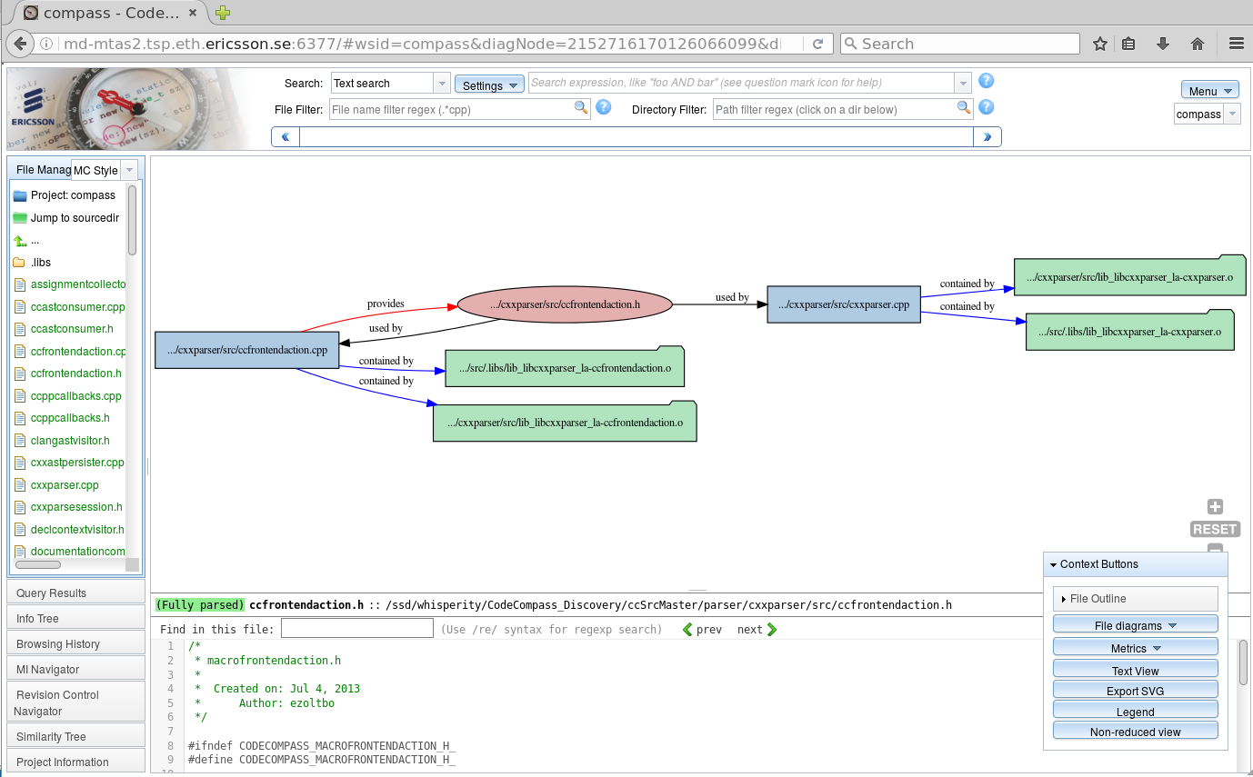
Architectural information

Slide 38
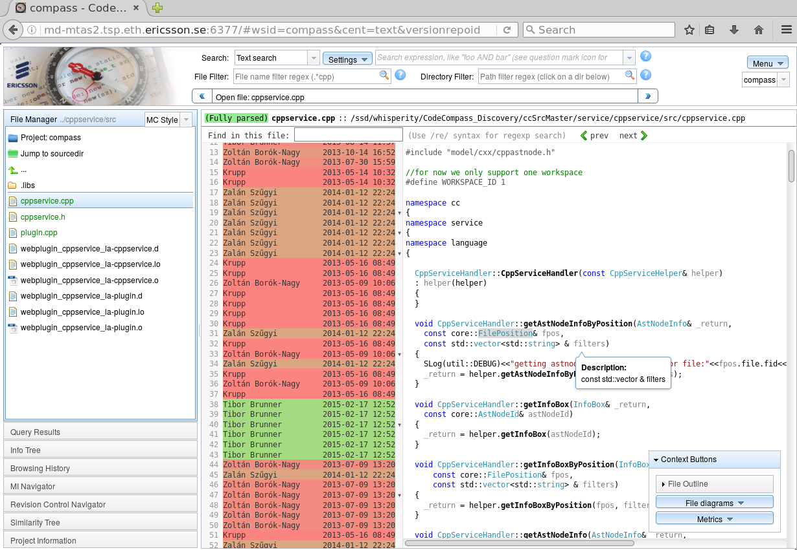
Version control information

Slide 39
Typical workflow
  Fast feature location
    Textual search
    Log-base search
  Extend knowledge
    Info tree
    CodeBites view
    Function call chains
    Browsing history
  Validate knowledge
    All references
    Architectural info
    Version control info

Slide 40
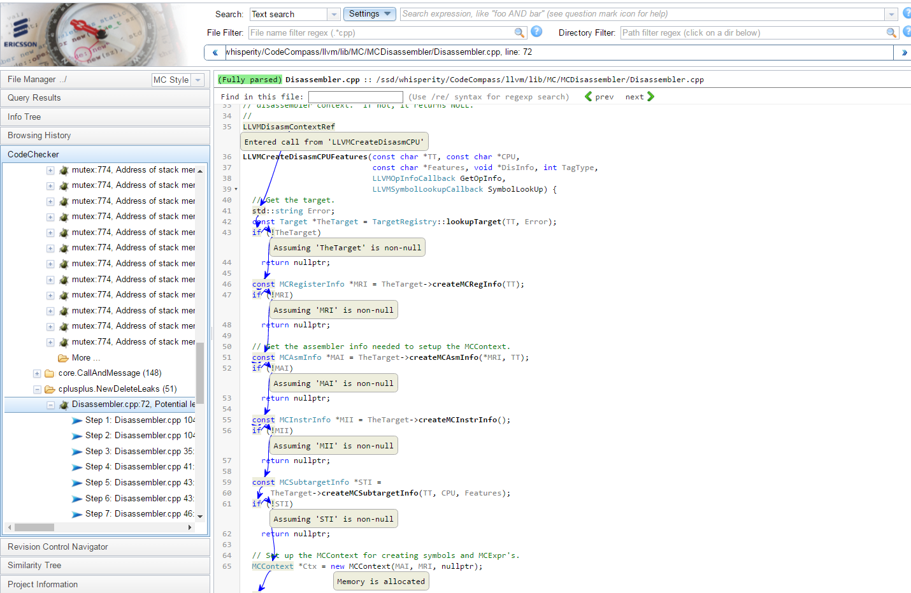
Static Analysis / CodeChecker

Slide 41
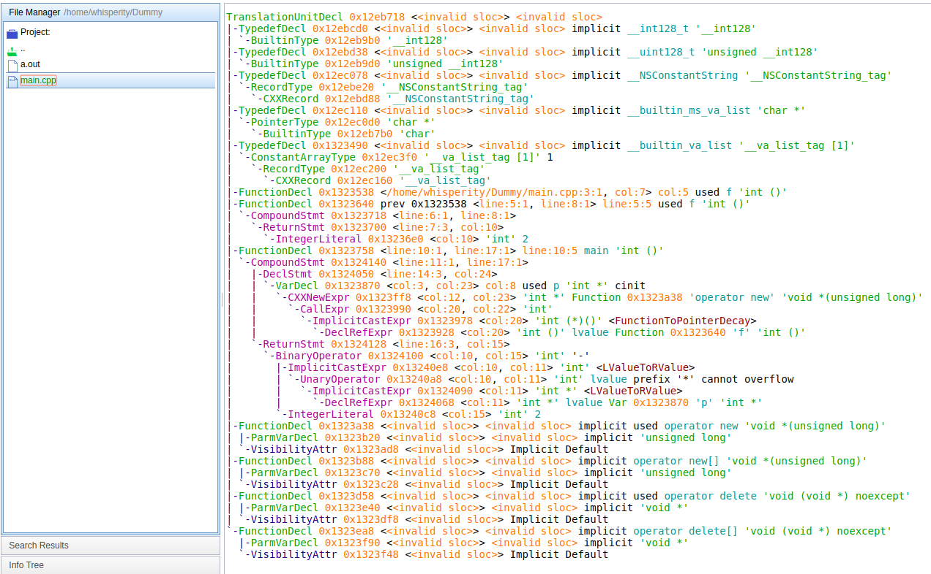
Reparse

Slide 42
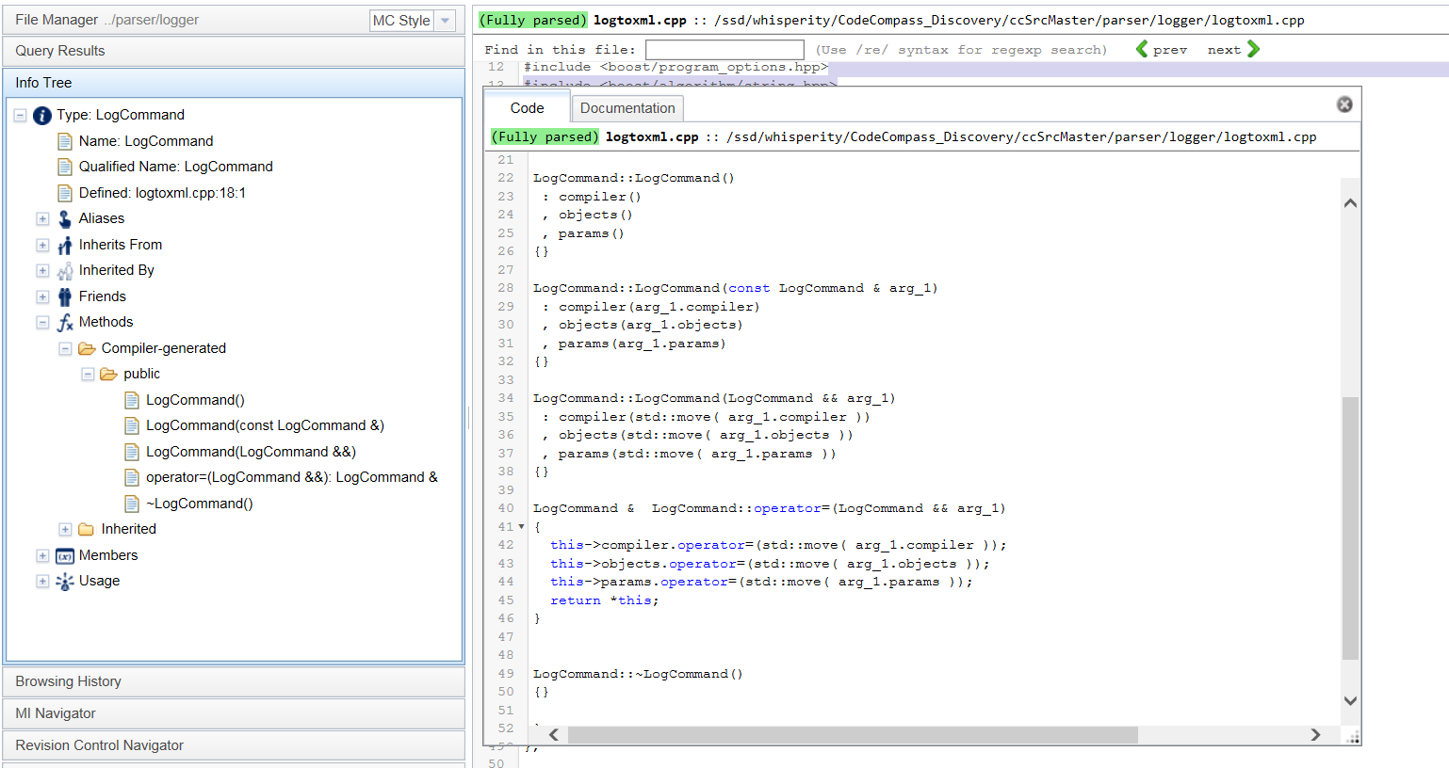
Generated special methods

Slide 43
Experiences with CodeCompass
  Open source since Summer 2016
  Inside Ericsson
    Voluntary based: no policy to enforce using CodeCompass
    Replacing/extending openGrok and others
    Frequently used together with CodeChecker
    ~40 million lines of code parsed inside Ericsson
    ~300-400 users
    ~10% is very active
  A few known users outside of Ericsson
    We intentionally do not collect information about users

Slide 44
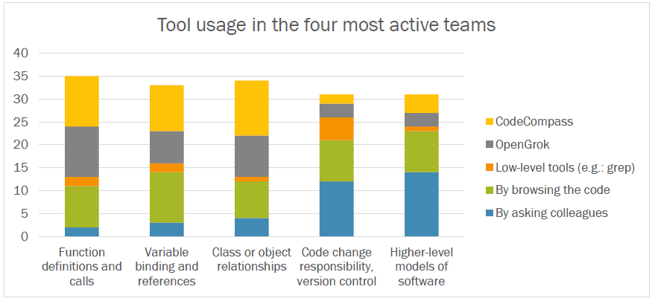
Experiences with CodeCompass

Slide 45
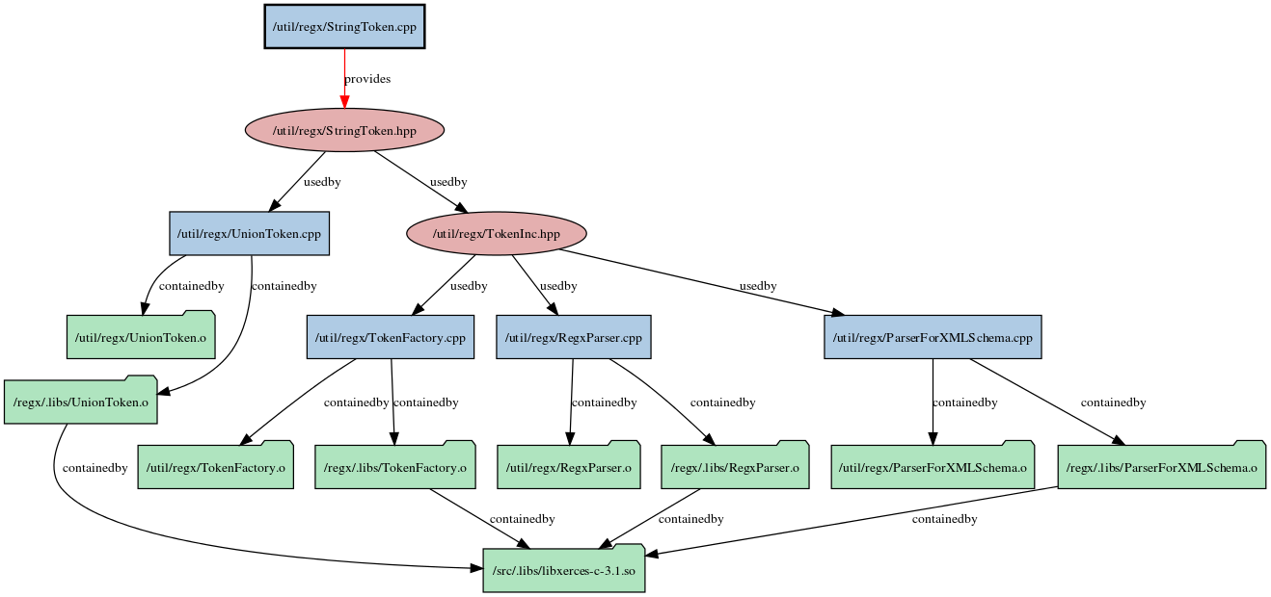

Experiences with CodeCompass

Slide 46

Static analysis

Slide 47
Finding bugs with static analysis
All methods are using heuristics
Over- or underestimate program behavior
Neither sound nor complete
False negatives and false positives
The biggest problem is the false positive reports

Slide 48


Finding bugs with static analysis
Code Change
Static
Analysis
Test
Manual
Code
Review
Ready to commit
CI
Actions
Report coding errors
Quick Feedback
Overnight analysis
Rigorous, longer static analysis run daily (e.g. CTU)

Slide 49
Bug-finding methods
Regular expression matching
AST-based
Symbolic execution
Concolic execution
Data flow analysis

Slide 50
Pattern matching
Early versions of CppCheck
Transform source to canonical format
Apply rules in for of regular expression
Context free -- weak detection capability
Very low false positive rate
void f()
{
int t[10];
:
t[10] = 0; // array bound error
}
void g()
{
int *ip;
:
ip = (int*) malloc(sizeof(ip)); // found
ip = (int*) malloc(sizeof(double)); // not found
}

Slide 51
AST-based matching
Most of the „Linter” tools, e.g. Clang Tidy
Constructs the Abstract Syntax Tree (AST)
Find patterns and then discover the environment
Context sensitive, put not path sensitive
Algorithmic complexity: O(|branches|)
#define ZERO 0
int f() { return 0; }
int g(int b)
{
int a;
switch(b)
{
case 1: a = b/0; break; // found
case 2: a = b/ZERO; break; // found
case 3: a = 10/(b-3); break; // not found
case 4: a = 10/f(); break; // not found
}
return a;
}

Slide 52
Symbolic execution
Most advanced tools, e.g. Clang SA, Coverity, etc.
Interprets the code on all possible execution paths
Use symbolic values/intervals to represent variables
Known functions are inlined
Use SAT solver to eliminate impossible paths
Context sensitive, path sensitive
Algorithmic complexity: O(2^{|branches|})
Mostly for existency check, not universal properties
#define ZERO 0
int f() { return 0; }
int g(int b)
{
int a;
switch(b)
{
case 1: a = b/0; break; // found
case 2: a = b/ZERO; break; // found
case 3: a = 10/(b-3); break; // not found
case 4: a = 10/f(); break; // not found
}
return a;
}

Slide 53
Symbolic execution
#define ZERO 0
int f() { return 0; }
int g(int b)
{
int a;
switch(b)
{
case 1: a = b/0; break; // found
case 2: a = b/ZERO; break; // found
case 3: a = 10/(b-3); break; // not found
case 4: a = 10/f(); break; // not found
}
return a;
}
b: $b
switch(b)
case 4
b: $b
b: $b
$b=[1,1]
b: $b
$b=[4,4]
$b=[MIN_INT,0],[2,2],[4,MAX_INT]
a = b/0;
x = b-3;
b: $b
b: $b
c: 0
$b=[3,3];
x=$b-3
x=0
a = 10/x;
b: $b
c: 0
$b=[3.3]
a=10/$x
Division by zero

Slide 54

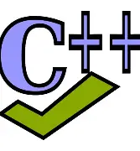




Bug-finding methods
Clang-Tidy
Regular expression matching
AST-based
Symbolic execution
Concolic execution
Data flow analysis
The more methods and the more tools we use the more error we catch
Clang SA
Facebook Infer

Slide 55
Bug-finding methods
Clang-Tidy
Regular expression matching
AST-based
Symbolic execution
Concolic execution
Data flow analysis
The more methods and the more tools we use the more error we catch
... but the more burden is on the developer
Clang SA
Facebook Infer

Slide 56
What the developers want from static analysis tools
The top 3 issue
Easy configurability
Clear reports
Less false positives

Slide 57
CodeChecker
Open-source static analysis framework in Python
Executes multiply analyzers in a universal parametrisation
Collects and stores the reports in a database
Unify the findings*
Filter, compare, present and manage findings
Annotate the findings
Easy to integrate into CI/CD pipelines
https://github.com/ericsson/codechecker
*almost done

Slide 58

CodeChecker architecture
Browser
Clang Tidy
clang.llvm.org
CodeChecker
Report Mgmt
Web Server
CodeChecker
cmd line
analyzer
toolset
GIT (CI) Commit Loop utilities
Clang SA
clang-analyzer.llvm.org
E/// Checkers
Eclipse client
VSCode client
NeoVIM client
Analyzer
Report Storage
1
Ericsson
only checkers
3
2
Viewer & Report
Management
Features
New Analyzer Features
Cross Translation Unit Analysis
Statistical Checkers

Slide 59
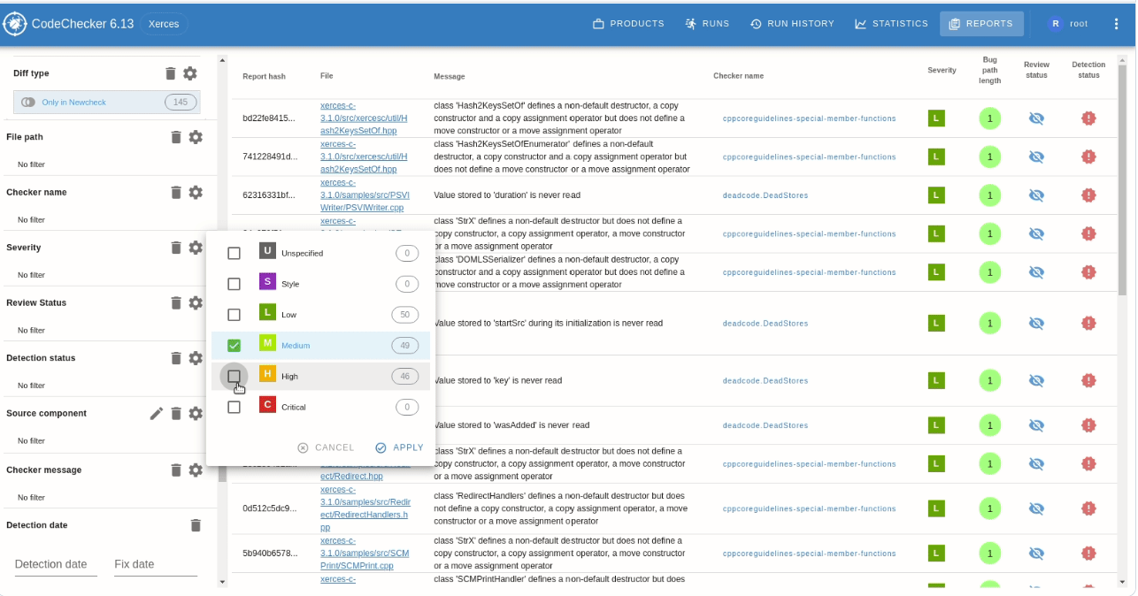
CodeChecker usage

Slide 60
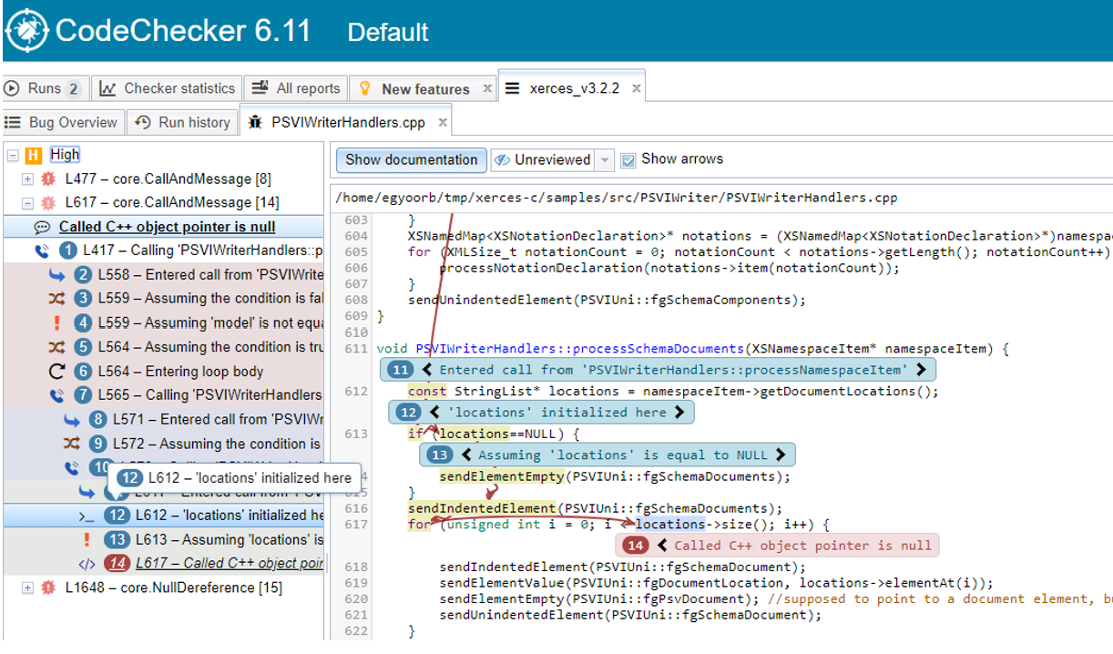
CodeChecker usage

Slide 61
CodeChecker users
Industry
Ericsson
Google running on Chromium, Fuchsia
Mozilla running on Firefox
Electronic Arts
BMW
Sony
Samsung
Academy
Wright University, Ohio, US -- Secure software lab curriculum

Slide 62
Gitlab
GitLab Advanced SAST (Static Application Security Testing)
Wrapped as a Docker image
Pre-installed and integrated to the default SAST configuration template
CodeChecker users

Slide 63
CodeChecker success factors
Build integration
Strong integration to the build system (Cmake, Bazel or LD_PRELOAD based)
Using the newest C/C++ parser
Storing the result in database and query it in various ways
Strong visualization
Tool agnostic/Easy integration of new tools
Reacting the user feadback

Slide 64
Some interesting development
Cross-translational unit checks
Statistical checks
Modelling standard library lifetime (e.g., std::string and std::string_view class)
Detecting misuse of tagged-unions and std::variant classes
Improving the taint analyzis
Detecting regular expression misuses

Slide 65
Static analysis software lab
Academia-industry co-oporation with Ericsson, Bosh, Erlang Solution, OTP Bank, etc.
Students work on industry-motivated open-source projects
Supervised by PhD students and industry developers
BSc, MSc and PhD students can participate, MSc students can receive credits
Students learn soft- and hard skills, participation in open-source projects, reacting the reviews
Source of many BSc and MSc theses, academic papers, PhD theses
Many students find their first job at the industrial partners.
CodeCompass now is 100% developed and maintained by software lab students
CodeChecker has a huge student involvement of checker development

Slide 66
Future challanges
Improve Clang Static Analyzer engine
Further reduce false positives
Better taint analysis
Better integrate data flow analysis into current methods
Further improve warning quality
AI integration (?)

Slide 67
References
[1] D. Farago, F. Merz, C.Sinz:
Automatic Heavy-weight Static Analysis Tools for Finding Bugs in Safety-critical Embedded C/C++ Code
[2] Par Emanuelsson and Ulf Nilsson, A Comparative Study of Industrial Static Analysis Tools
[3] G. Horvath, Make Friends with the Clang Static Analysis tools, CppCon 2016
[4] CodeChecker: https://github.com/Ericsson/codechecker
[5] Clang: http://clang.llvm.org/
[6] Clang Static Analyzer: http://clang-analyzer.llvm.org/
[7] Clang Tidy: http://clang.llvm.org/extra/clang-tidy/
[9] CodeChecker on GITHUB: https://github.com/Ericsson/codechecker
[10] CodeChecker on OpenALM: https://openalm.lmera.ericsson.se/projects/codechecker
[11] CodeCompass: https://github.com/Ericsson/codecompass
[12] CodeCompass trial site: https://codecompass.net
[13] G. Márton, D. Krupp: Tool talk: CodeChecker https://www.youtube.com/watch?v=bVqrhaoxHlc, PLDI 2020

Slide 68
Industrial experiences in the use of static analysis
Zoltán Porkoláb
gsd@inf.elte.hu
zoltan.porkolab@ericsson.com
https://gsd.web.elte.hu
https://github.com/Ericsson/codecompass
https://github.com/Ericsson/codechecker

